Slide 1
Part 2: The Data Link Layer Txt, Reading: chapter 3.1, 3.2, 3.3, 3.4, 3.6.2

Slide 2
Summary
Part A Functions
Functions of the data link layer
Framing
Error control
(3.1) Error detection
(3.2) Error correction
Flow control
Part B Protocols
Definitions
Elementary data link protocols
Sliding window protocols
Example data link protocol - PPP

Slide 3
Part A: Functions
Notes:
Research on DTN, Localization

Slide 4
(1) Functions of the Data Link Layer
Provide service interface to the network layer
Dealing with transmission errors
Regulating data flow
Slow receivers not swamped by fast senders
Notes:
Research on DTN, Localization

Slide 5
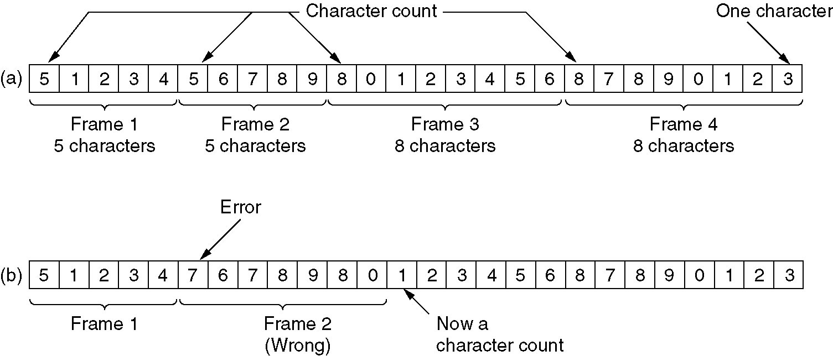
(2.1) Framing
A character stream. (a) Without errors. (b) With one error.

Slide 6
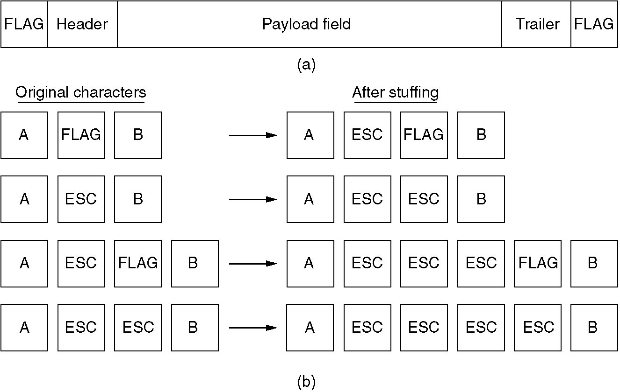
(2.2) Framing
(a) A frame delimited by flag bytes.
(b) Four examples of byte sequences before and after stuffing.

Slide 7
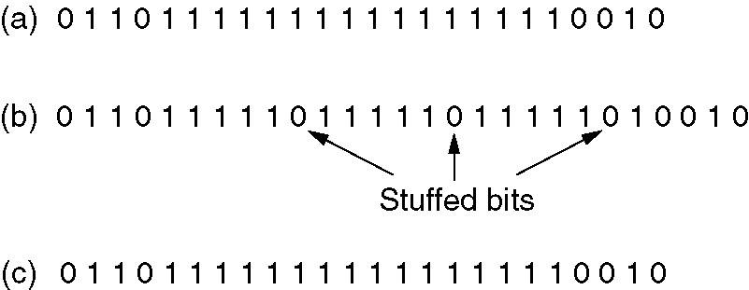
(2.3) Framing
Bit stuffing
(a) The original data.
(b) The data as they appear on the line.
(c) The data as they are stored in receiver’s memory after destuffing.

Slide 8
(2.4) Framing
Physical Layer Coding Violations:
Used only when physical medium contains some redundancy
1: high-low
0: low-high
high-high and low-low are used for delimiting frames
Notes:
Seldom used

Slide 9
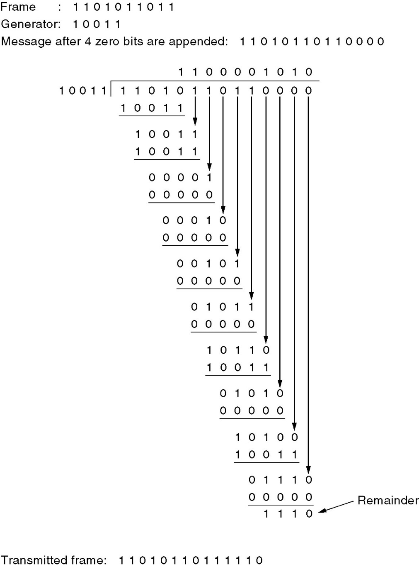
(3.1) Error-Detecting Codes
Calculation of the polynomial code checksum.

Slide 10
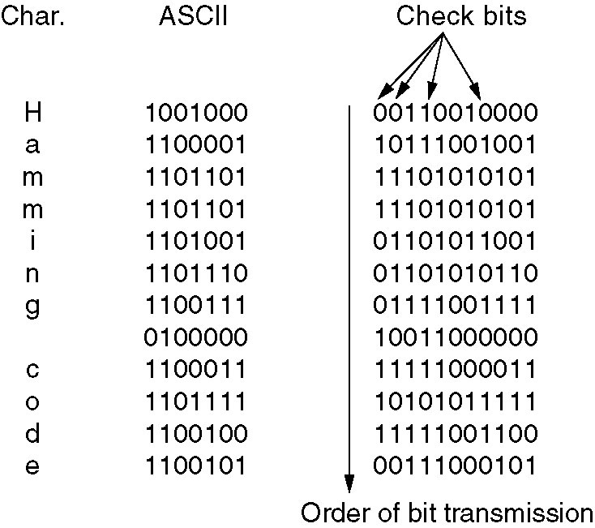
(3.2) Error-Correcting Codes
Use of a Hamming code to correct burst errors.

Slide 11
(4) Flow Control
Feedback-based flow control
Rate-based flow control

Slide 12
Part B: Protocols
Definitions
Elementary data link protocols
Sliding window protocols
Example data link protocol - PPP

Slide 13
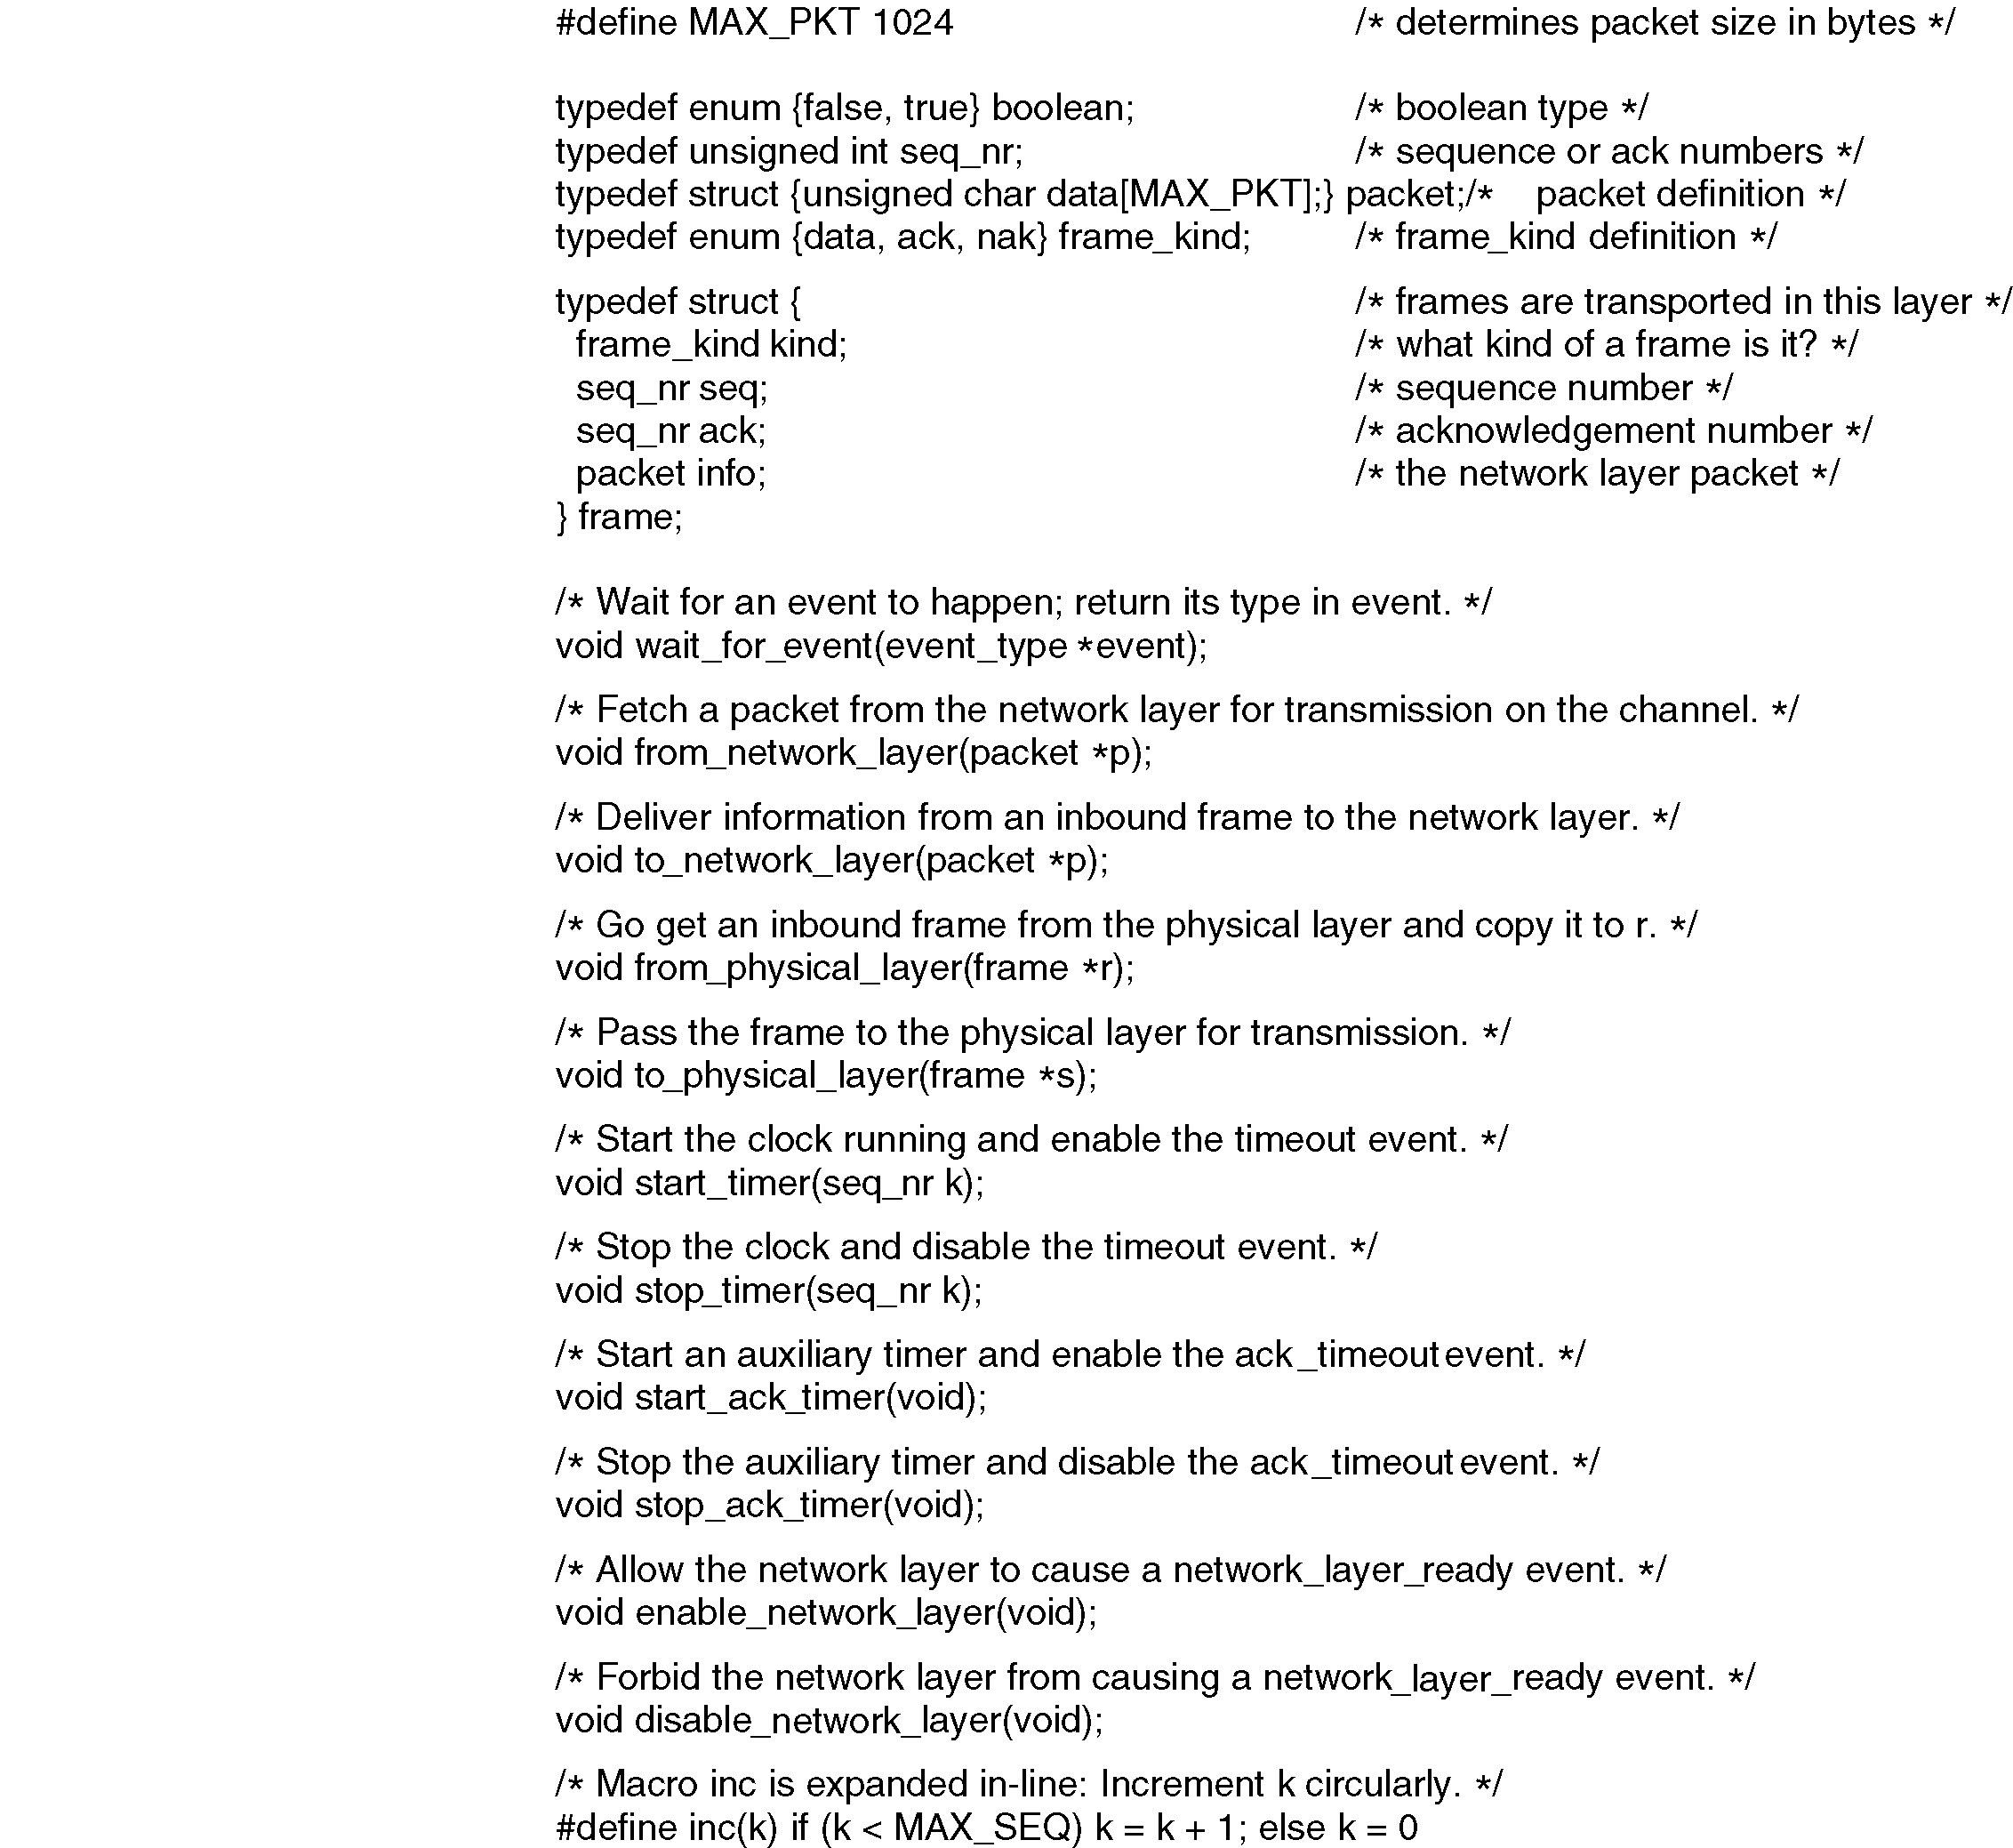
(1.1) Protocol Definitions
Continued →
Some definitions needed in the protocols to follow. These are located in the file protocol.h.

Slide 14
(1.2)Protocol Definitions (ctd.)
Some definitions needed in the protocols to follow. These are located in the file protocol.h.

Slide 15
(2) Elementary Data Link Protocols
An Unrestricted Simplex Protocol
A Simplex Stop-and-Wait Protocol
A Simplex Protocol for a Noisy Channel

Slide 16
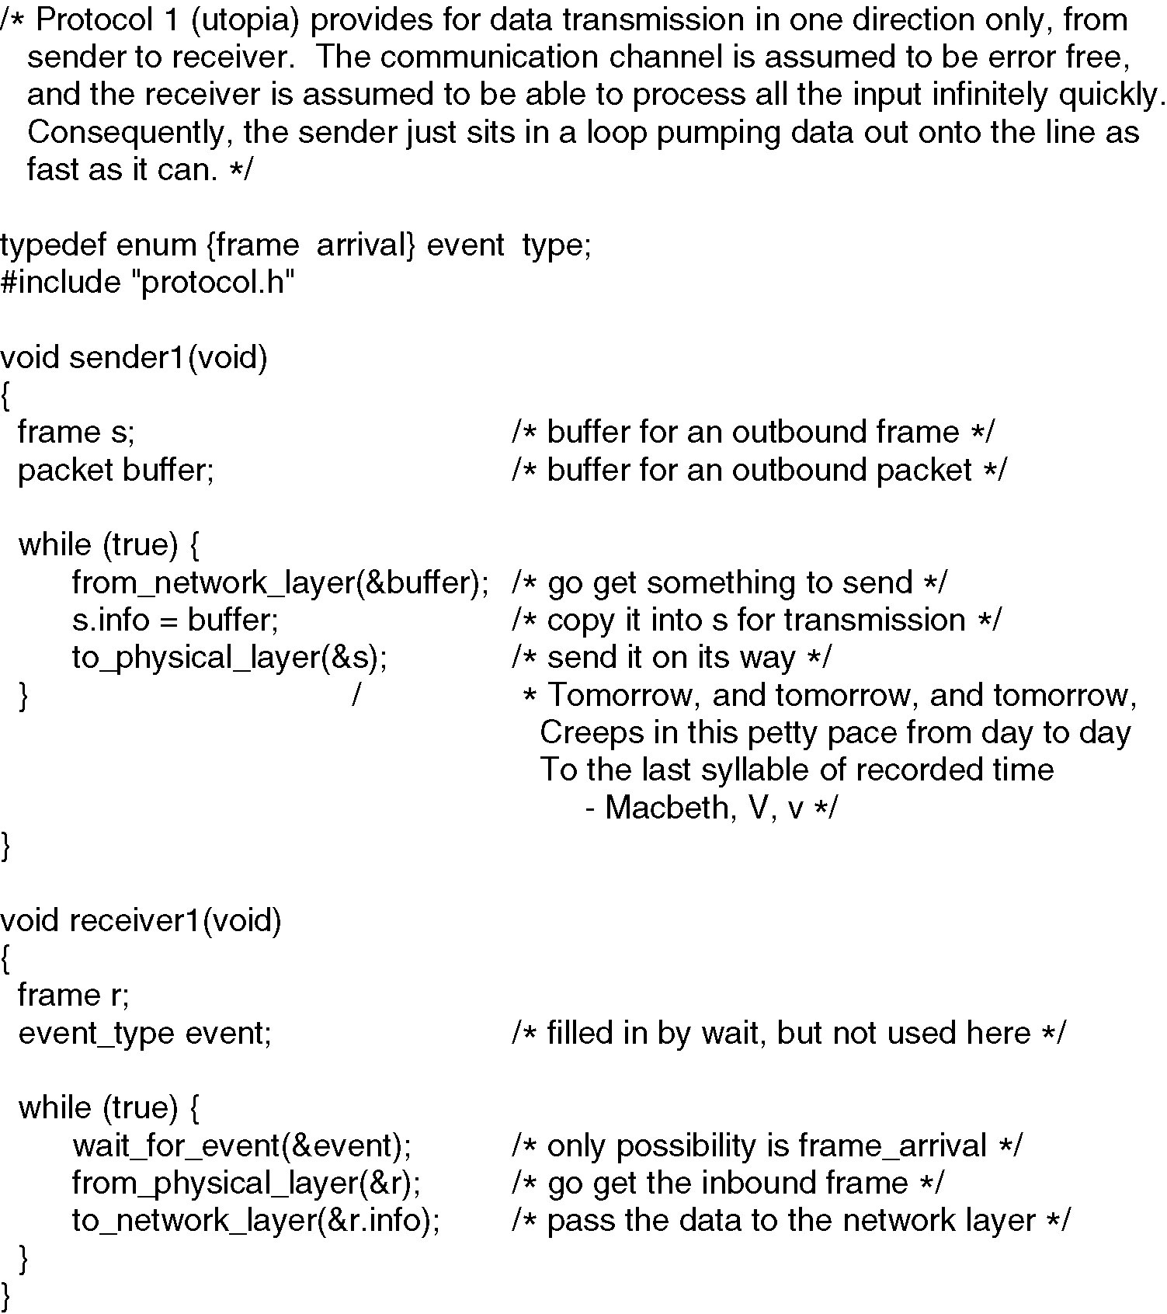
(2.1) Unrestricted Simplex Protocol

Slide 17
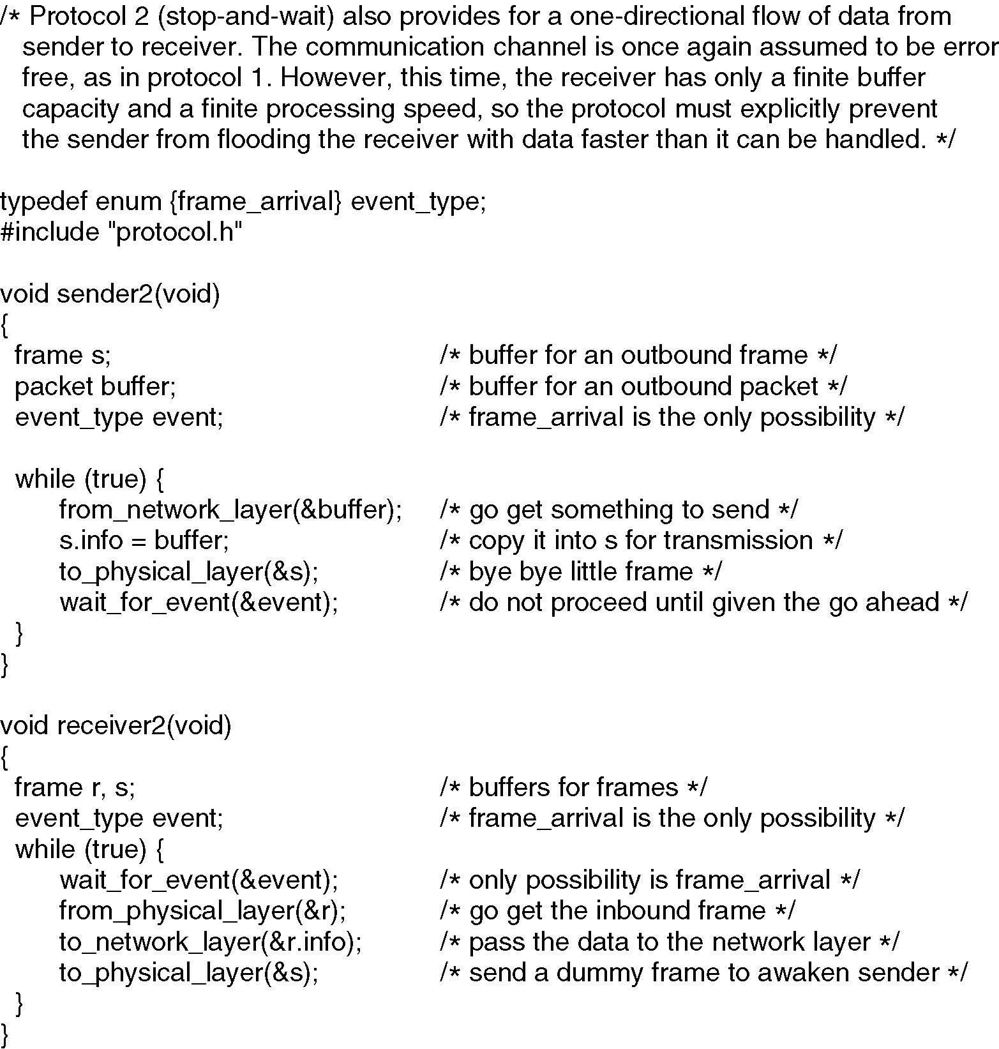
(2.2) Simplex Stop-and-Wait Protocol

Slide 18
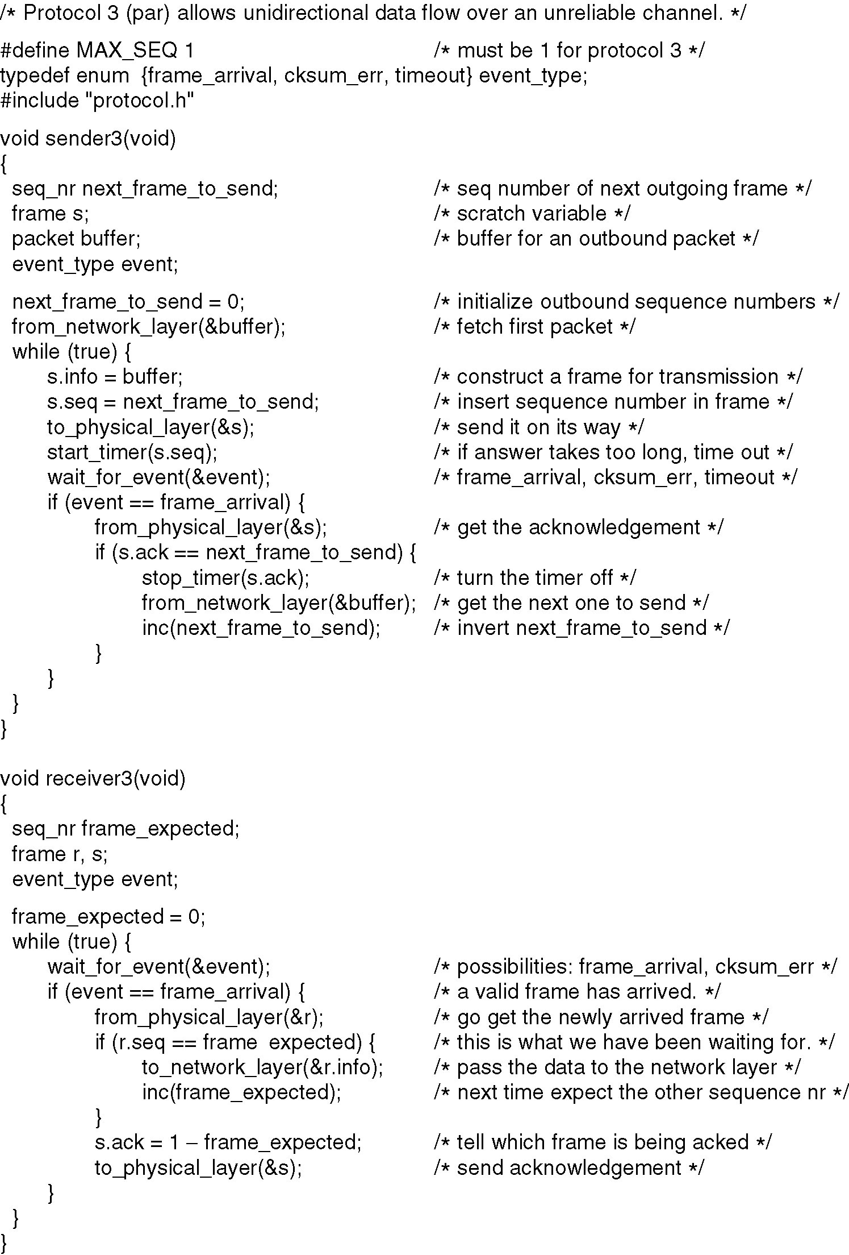
(2.3.1)A Simplex Protocol for a Noisy Channel
A positive acknowledgement with retransmission protocol.
Continued →

Slide 19
(2.3.2) A Simplex Protocol for a Noisy Channel (ctd.)
A positive acknowledgement with retransmission protocol.

Slide 20
(3) Sliding Window Protocols
A One-Bit Sliding Window Protocol
A Protocol Using Go Back N
A Protocol Using Selective Repeat

Slide 21
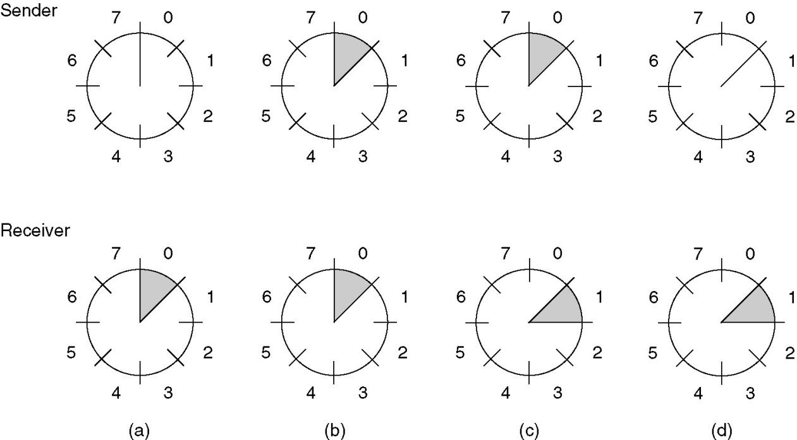
(3) Sliding Window Protocols (2)
A sliding window of size 1, with a 3-bit sequence number.
(a) Initially.
(b) After the first frame has been sent.
(c) After the first frame has been received.
(d) After the first acknowledgement has been received.

Slide 22
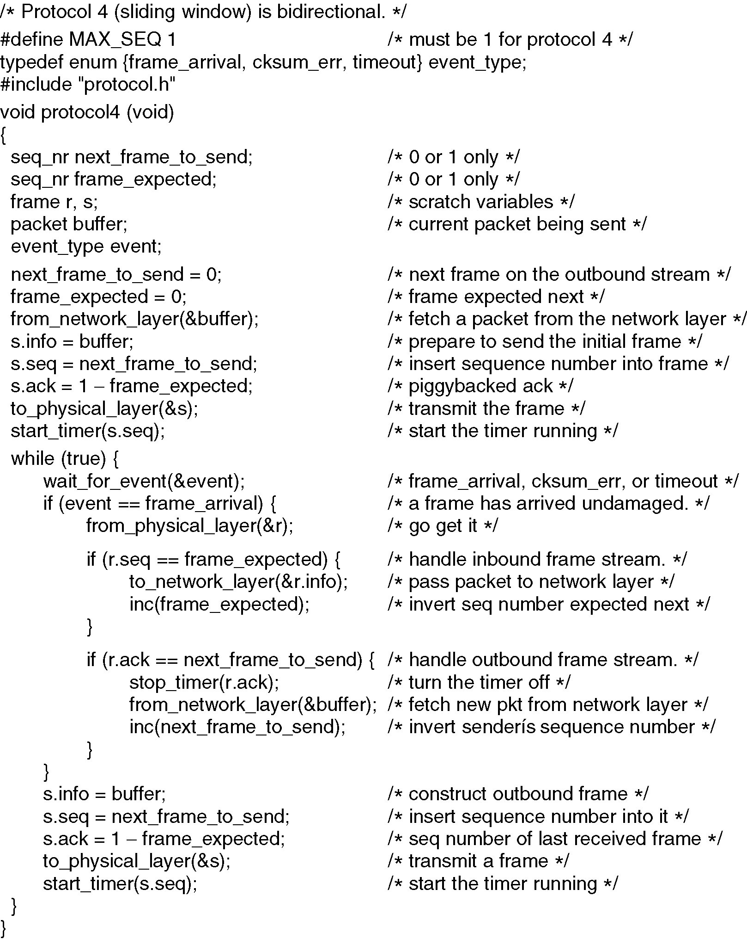
(3.1.1) A One-Bit Sliding Window Protocol
Continued →

Slide 23
(3.1.2) A One-Bit Sliding Window Protocol (ctd.)

Slide 24
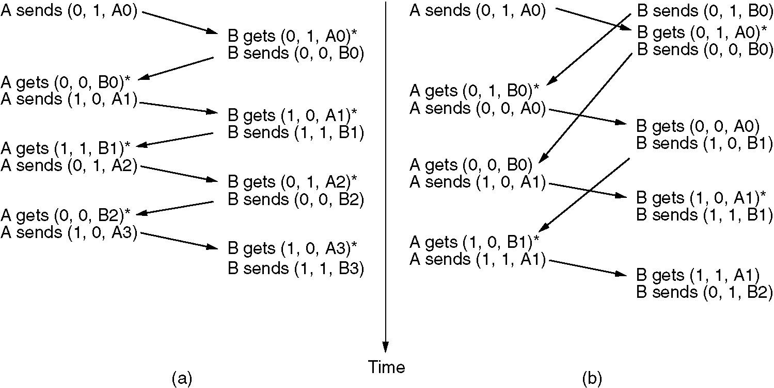
(3.1.3) A One-Bit Sliding Window Protocol
Two scenarios for protocol 4. (a) Normal case. (b) Abnormal case. The notation is (seq, ack, packet number). An asterisk indicates where a network layer accepts a packet.

Slide 25
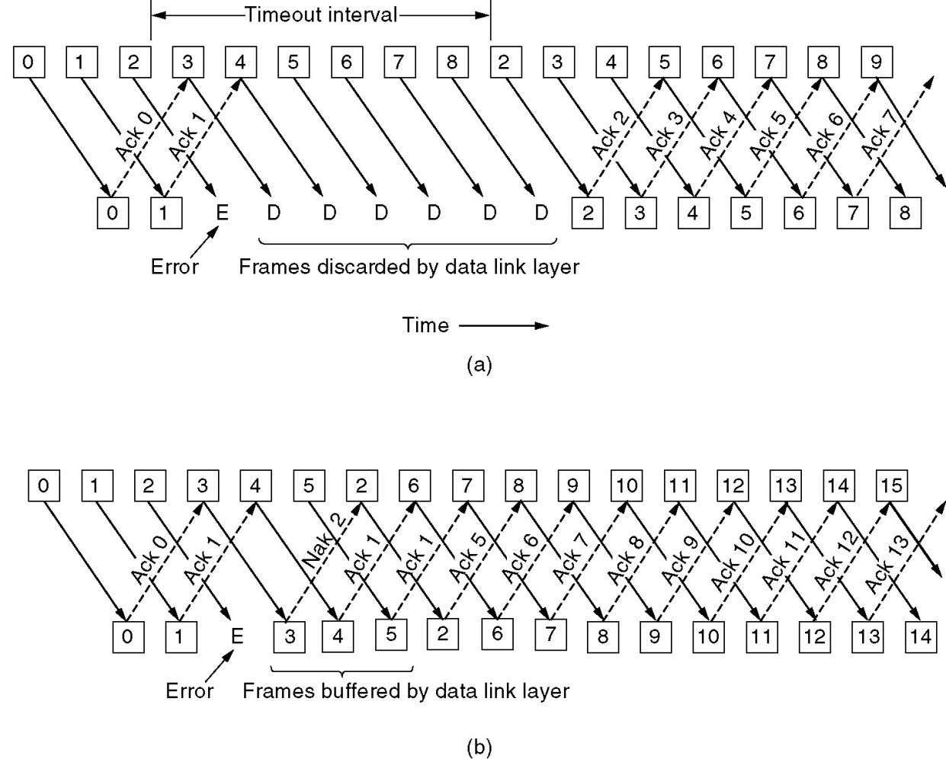
(3.2.1) A Protocol Using Go Back N
Pipelining and error recovery. Effect on an error when
(a) Receiver’s window size is 1.
(b) Receiver’s window size is large.

Slide 26
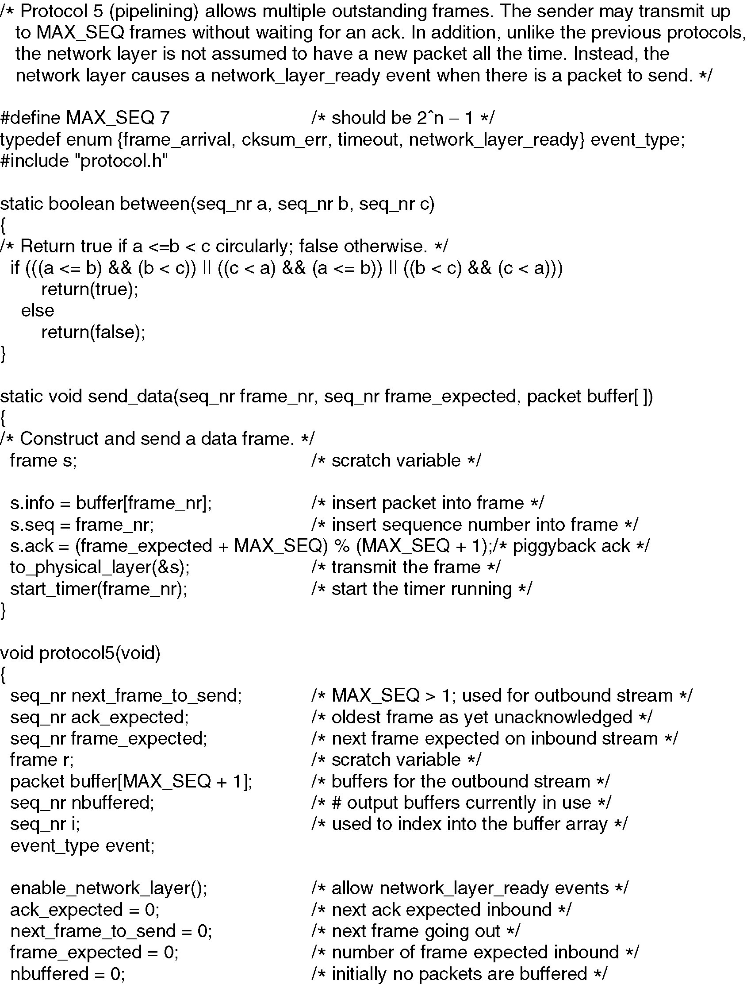
(3.2.2) Sliding Window Protocol Using Go Back N
Continued →

Slide 27
(3.2.3) Sliding Window Protocol Using Go Back N
Continued →

Slide 28
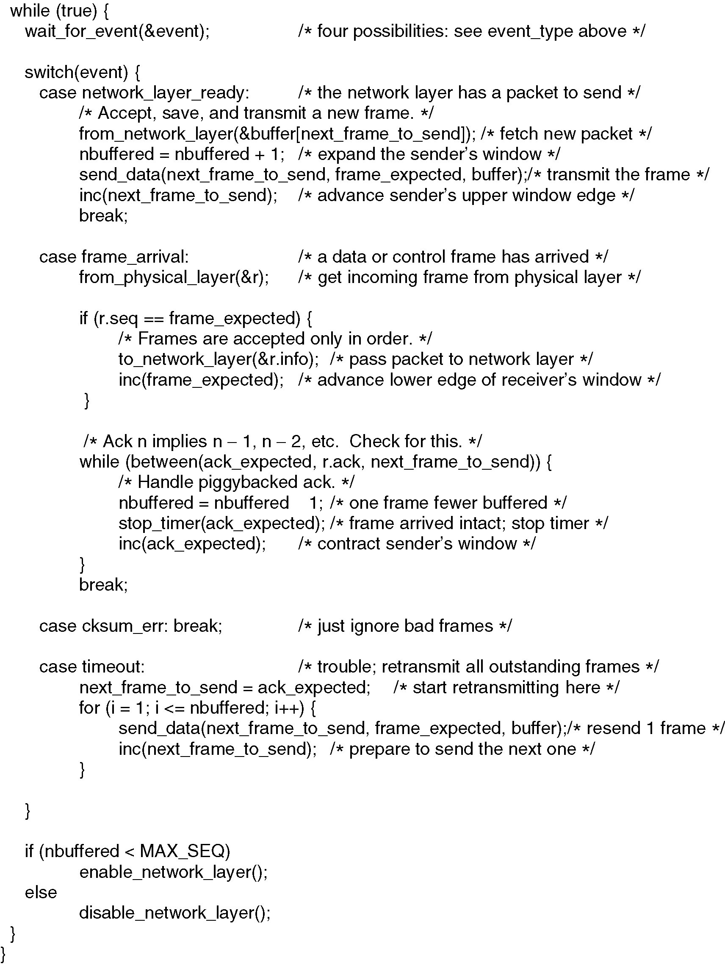
(3.2.4) Sliding Window Protocol Using Go Back N
Continued →

Slide 29
(3.2.5) Sliding Window Protocol Using Go Back N

Slide 30
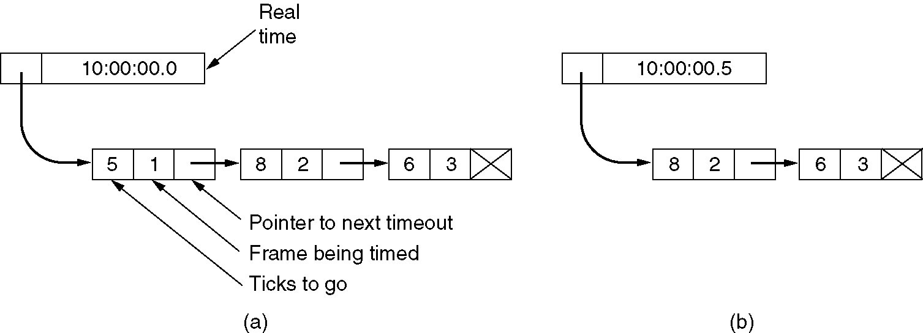
(3.2.6) Sliding Window Protocol Using Go Back N
Simulation of multiple timers in software.

Slide 31
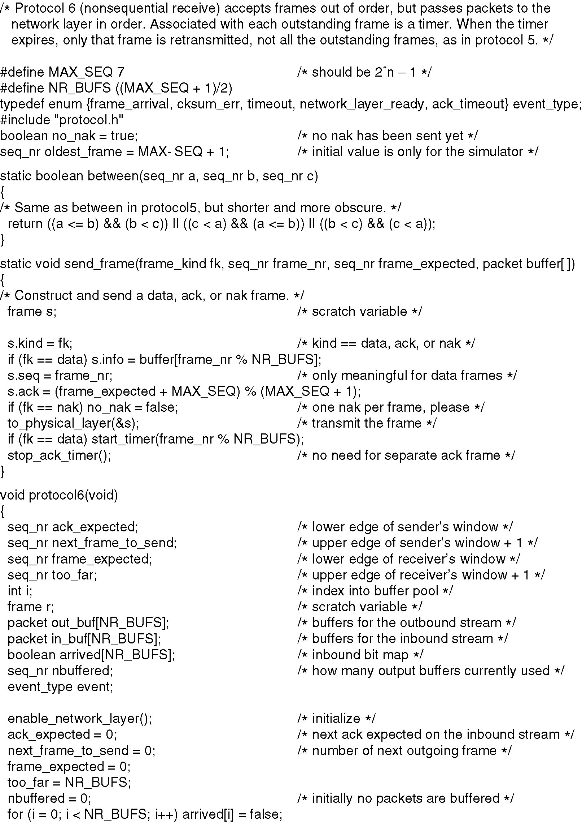
(3.3.1) A Sliding Window Protocol Using Selective Repeat
Continued →

Slide 32
(3.3.2) A Sliding Window Protocol Using Selective Repeat
Continued →

Slide 33
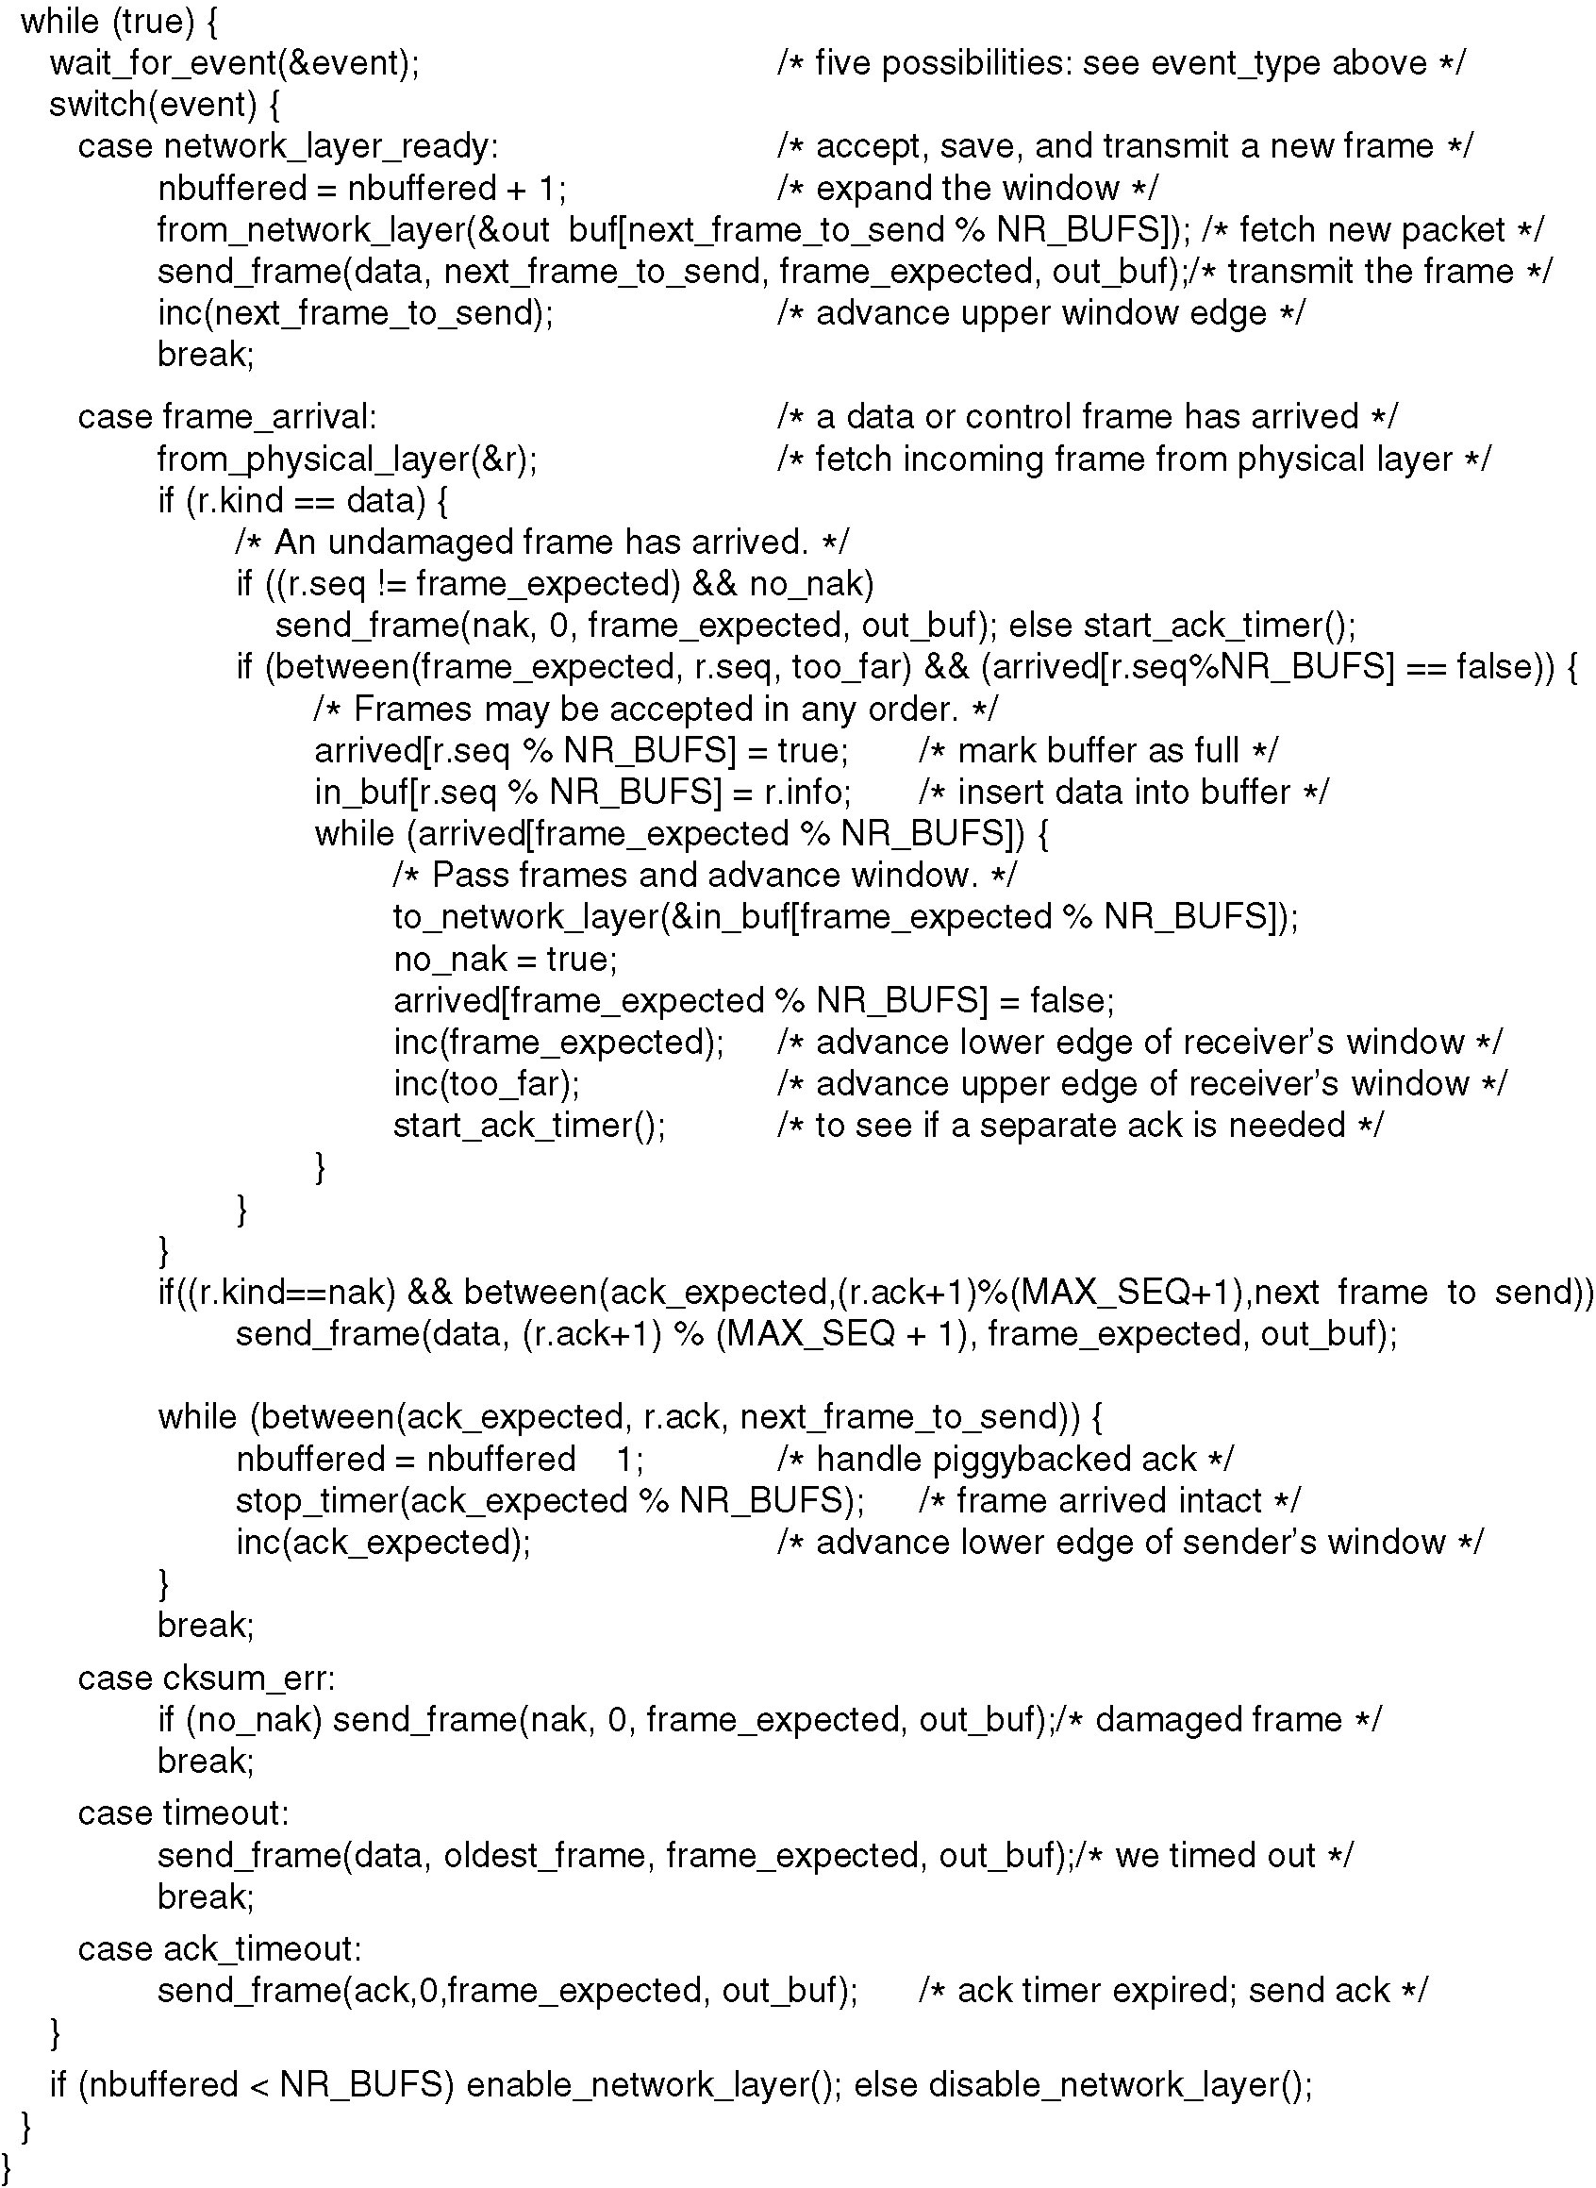
(3.3.3) A Sliding Window Protocol Using Selective Repeat
Continued →

Slide 34
(3.3.4) A Sliding Window Protocol Using Selective Repeat

Slide 35
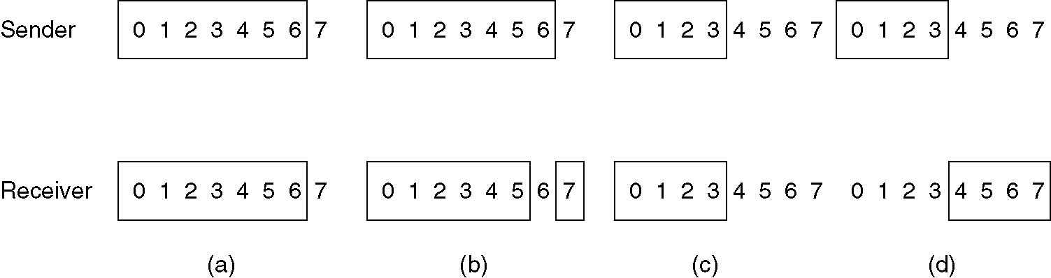
(3.3.5) A Sliding Window Protocol Using Selective Repeat
(a) Initial situation with a window size seven.
(b) After seven frames sent and received, but not acknowledged.
(c) Initial situation with a window size of four.
(d) After four frames sent and received, but not acknowledged.

Slide 36
(4) PPP
Read RFC 1661: http://www.faqs.org/rfcs/rfc1661.html

Slide 37
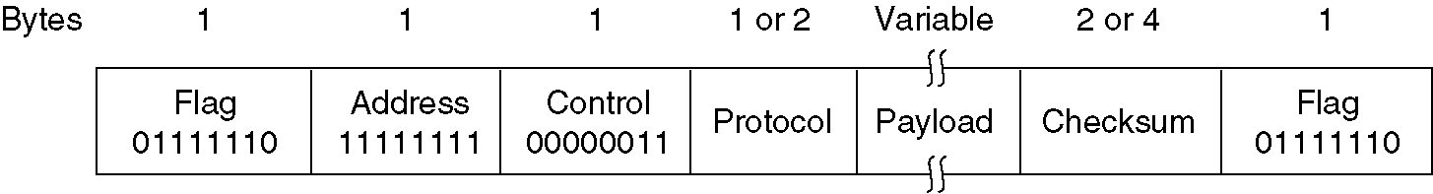
(4.1) PPP – Point to Point Protocol
The PPP full frame format for unnumbered mode operation.

Slide 38
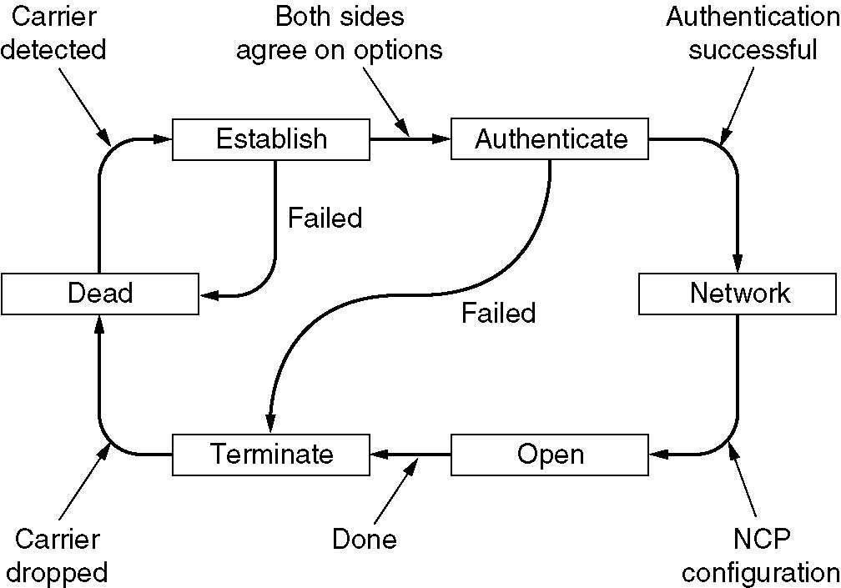
(4.2) PPP – Point to Point Protocol
A simplified phase diagram for bring a line up and down.

Slide 39
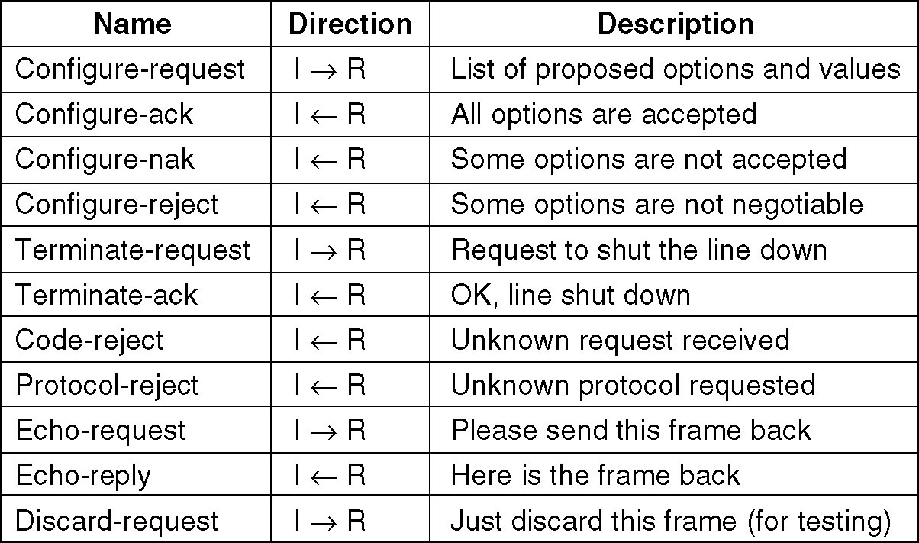
(4.3) PPP – Point to Point Protocol
The LCP frame types.

